Slide 1
WEB APPLICATION DEVELOPMENT TRAINING
PHP Mail Function, File Upload, String Function and Date Function

Slide 2
What Else Can you do with Your Form Data?

Slide 3
Sending Mails – Mail Function
Sending auto responder using the mail() function
The mail() function allows you to send emails directly from a script.
The behavior of the mail functions is affected by settings in php.ini
mail(to,subject,message,headers,parameters);
The last two are optional parameters.

Slide 4
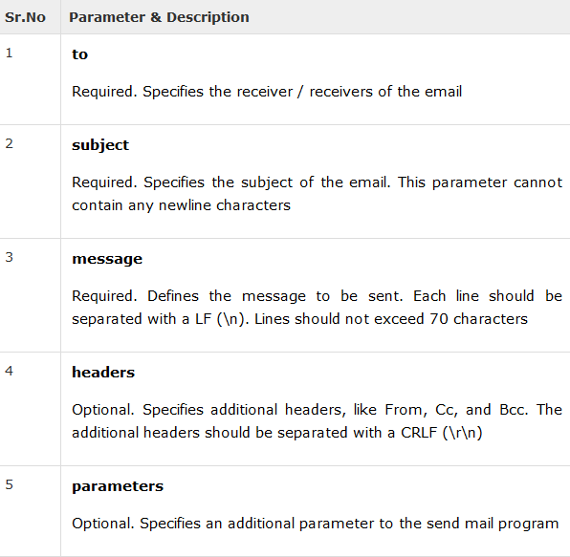

Slide 5
Sending HTML Email
PHP provides option to send an HTML message as actual HTML message.
While sending an email message you can specify a Mime version, content type and character set to send an HTML email
$header = "From:abc@somedomain.com \r\n"; $header .= "Cc:afgh@somedomain.com \r\n"; $header .= "MIME-Version: 1.0\r\n"; $header .= "Content-type: text/html\r\n";

Slide 6
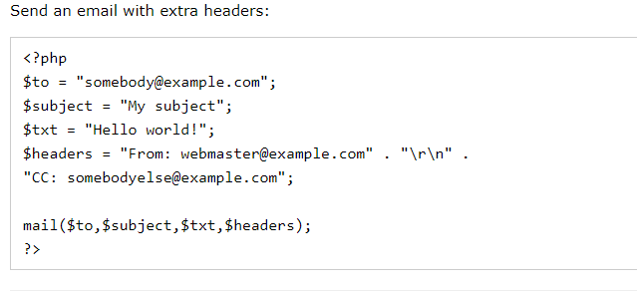
Send Email with Headers

Slide 7
Class Exercise
Create a Password Reminder page that allows users to have their passwords sent to them by email.
The page should contains a simple form that submits to the same page.
BCC yourself on the email.
If the email fails to send, output the error to the browser. Otherwise, let the user know the password has been sent.

Slide 8
File Upload
A PHP script can be used with a HTML form to allow users to upload files to the server. Initially files are uploaded into a temporary directory and then relocated to a target destination by a PHP script.
Information in the phpinfo.php page describes the temporary directory that is used for file uploads as upload_tmp_dir and the maximum permitted size of files that can be uploaded is stated as upload_max_filesize. These parameters are set into PHP configuration file php.ini

Slide 9
File Upload
A PHP script can be used with a HTML form to allow users to upload files to the server. Initially files are uploaded into a temporary directory and then relocated to a target destination by a PHP script.
Information in the phpinfo.php page describes the temporary directory that is used for file uploads as upload_tmp_dir and the maximum permitted size of files that can be uploaded is stated as upload_max_filesize. These parameters are set into PHP configuration file php.ini

Slide 10
File Upload
The process of uploading a file follows these steps −
The user opens the page containing a HTML form featuring a text files, a browse button and a submit button.
The user clicks the browse button and selects a file to upload from the local PC.
The full path to the selected file appears in the text filed then the user clicks the submit button.
The selected file is sent to the temporary directory on the server.
The PHP script that was specified as the form handler in the form's action attribute checks that the file has arrived and then copies the file into an intended directory.
The PHP script confirms the success to the user.

Slide 11
Creating an upload form
The following HTM code below creates an uploader form. This form is having method attribute set to post and enctype attribute is set to multipart/form-data
<!DOCTYPE html>
<html>
<body>
<form action="upload.php" method="post" enctype="multipart/form-data">
Select image to upload:
<input type="file" name="fileToUpload" id="fileToUpload">
<input type="submit" value="Upload Image" name="submit">
</form>
</body>
</html>

Slide 12
Creating an upload PHP script
There is one global PHP variable called $_FILES. This variable is an associate double dimension array and keeps all the information related to uploaded file. So if the value assigned to the input's name attribute in uploading form was file, then PHP would create following five variables −
$_FILES['file']['tmp_name'] − the uploaded file in the temporary directory on the web server.
$_FILES['file']['name'] − the actual name of the uploaded file.
$_FILES['file']['size'] − the size in bytes of the uploaded file.
$_FILES['file']['type'] − the MIME type of the uploaded file.
$_FILES['file']['error'] − the error code associated with this file upload.

Slide 13
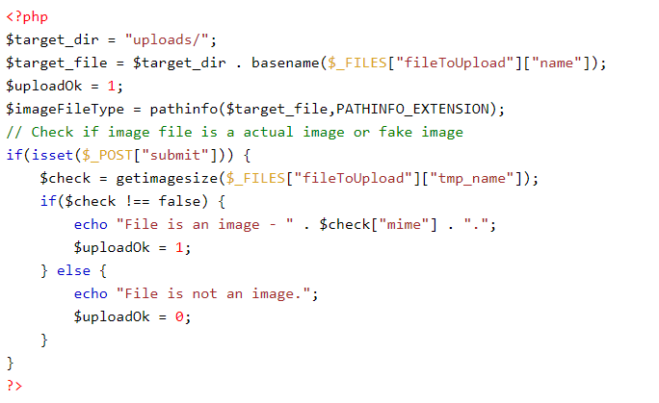
Creating an upload PHP script
Notes:
<?php if(isset($_FILES['image'])){ $errors= array(); $file_name = $_FILES['image']['name']; $file_size =$_FILES['image']['size']; $file_tmp =$_FILES['image']['tmp_name']; $file_type=$_FILES['image']['type']; $file_ext=strtolower(end(explode('.',$_FILES['image']['name']))); $expensions= array("jpeg","jpg","png"); if(in_array($file_ext,$expensions)=== false){ $errors[]="extension not allowed, please choose a JPEG or PNG file."; } if($file_size > 2097152){ $errors[]='File size must be excately 2 MB'; } if(empty($errors)==true){ move_uploaded_file($file_tmp,"images/".$file_name); echo "Success"; }else{ print_r($errors); } } ?>

Slide 14
Class Exercise
1. Create a Bootstrap Form to upload any file and use $_FILES global variable to print out the following on a separate line.
The uploaded file temporary name and directory on the web server.
The MIME type of the uploaded file
The size of the uploaded file
The actual name of the uploaded file

Slide 15
PHP String Function
The PHP string functions are part of the PHP core. No installation is required to use these functions.
PHP provides a number of built-in string functions which help in performing several operations while dealing with string data.
In this class, we will discuss a few basic string functions which are most commonly used in PHP scripts.
For more on String function check the PHP documentation on http://php.net/manual/en/book.strings.php

Slide 16
Basic PHP String Functions
1. Getting length of a String
PHP has a predefined function to get the length of a string. Strlen() displays the length of any string. It is more commonly used in validating input fields where the user is limited to enter a fixed length of characters.
Syntax:
Strlen(string);
Example:
<?php
echo strlen(“Welcome to Moat Academy”);//will return the length of given string
?>

Slide 17
Basic PHP String Functions
2. Counting of the number of words in a String
Another function which enables display of the number of words in any specific string is str_word_count(). This function is also useful in validation of input fields.
Syntax:
Str_word_count(string);
Example:
<?php
echo str_word_count(“Welcome to Moat Academy”);//will return the number of words in a string
?>

Slide 18
Basic PHP String Functions
3. Reversing a String
Strrev() is used for reversing a string. You can use this function to get the reverse version of any string.
Syntax:
Strrev(string);
Example:
<?php
echo Strrev(“Welcome to Moat Academy”); // will return the string starting from the end
?>

Slide 19
Basic PHP String Functions
4. Finding Text Within a String
Strpos() enables searching particular text within a string. It works simply by matching the specific text in a string. If found, then it returns the specific position. If not found at all, then it will return “False”. Strops() is most commonly used in validating input fields like email.
Syntax:
Strpos(string,text);
Example:
<?php
echo strpos(“Welcome to Moat Academy”,”Moat”);
?>

Slide 20
Basic PHP String Functions
5. Replacing text within a string
Str_replace() is a built-in function, basically used for replacing specific text within a string.
Syntax:
Str_replace(string to be replaced,text,string);
Example:
<?php
echo str_replace(“MoatAcademy”, “the programming world”, “Welcome to MoatAcademy”);
?>
Output:
Welcome to the programming world

Slide 21
Basic PHP String Functions
6. Converting lowercase into Title Case
Ucwords() is used to convert first alphabet of every word into uppercase.
Syntax:
Ucwords(string);
Example:
<?php
echo ucwords(“welcome to the php world”);
?>
Output:
Welcome To The Php World

Slide 22
Basic PHP String Functions
7. Converting a whole string into UPPERCASE
Strtoupper() is used to convert a whole string into uppercase.
Syntax:
Strtoupper(string);
Example:
<?php
echo strtoupper(“welcome to Moat Academy”);// It will convert all letters of string into uppercase?>
Output:
WELCOME TO MOAT ACADEMY

Slide 23
Basic PHP String Functions
8. Converting whole String to lowercase
Strtolower() is used to convert a string into lowercase.
Syntax:
Strtolower(string);
Example:
<?php
echo strtolower(“WELCOME TO MOAT ACADEMY”);
?>
Output:
Welcome to moat academy

Slide 24
Basic PHP String Functions
9. Repeating a String
PHP provides a built-in function for repeating a string a specific number of times.
Syntax:
Str_repeat(string,repeat);
Example:
<?php
echo str_repeat(“*”,15);
?>
Output:
***************

Slide 25
Basic PHP String Functions
10. Comparing Strings
You can compare two strings by using strcmp(). It returns output either greater than zero, less than zero or equal to zero. If string 1 is greater than string 2 then it returns greater than zero. If string 1 is less than string 2 then it returns less than zero. It returns zero, if the strings are equal.
Syntax:
Strcmp(string1,string2);
Example:
<?php
echo strcmp(“moat academy”,”moat academy”);//Both the strings are equal
?>
Output:
0

Slide 26
Basic PHP String Functions
11. Displaying part of String
Through substr() function you can display or extract a string from a particular position.
Syntax:
substr(string,start,length);
Example:
<?php
echo substr(“Welcome to Moat Academy”,6).”<br>”;
echo substr(“Welcome to Moat Academy”,0,10).”<br>”;
?>
Output:
e to Moat Academy
Welcome to

Slide 27
Basic PHP String Functions
11. Removing white spaces from a String
Trim() is dedicated to remove white spaces and predefined characters from a both the sides of a string.
Syntax:
trim(string,charlist);
Example:
<?php
$str = “Wordpess Hosting”;
echo $str . “<br>”;
echo trim(“$str”,”Wording”);
?>
Output:
Wordpess Hosting
pess Host

Slide 28
PHP String Functions Reference
https://www.w3schools.com/php/php_ref_string.asp

Slide 29
Class Exercise
Extract John Bull from this sentence using SUBSTR function
$sentence = “The Footballer, John Bull goes to stadium everyday.”
Echo the content of $sentence in CAPITAL Letters
Count the length of the variable $sentence
Count the number of words in $sentence

Slide 30
Basic PHP Date Functions
The date/time functions allow you to get the date and time from the server where your PHP script runs. You can then use the date/time functions to format the date and time in several ways.

Slide 31
Basic PHP Date Functions
Date()
It is used for formatting of date and time. It makes the timestamp more readable.
Syntax:
Date (format, timestamp);
Format: It is a mandatory field. Here you have to specify the format of the timestamp. For example: y/m/d or y-m-d.
Timestamp: This is an optional field. By default it selects the current date and time.
Definition of Timestamp:
Timestamp is basically a character sequence which denotes the timing (date + time) of certain event.

Slide 32
Basic PHP Date Functions
How to get a date in PHP
To get simple date, you have one of the parameters format in date(). Few characters need to be specified within the parameter.
1.’d’ for the day of month (1-31)
2.’m’ for month number (1-12)
3.’y’ stands for year(it should be 4 digit)
4.’l’ represents the day of week.
Furthermore, additional formatting can be applied through characters ‘/’,’.’ And ‘-’

Slide 33
Basic PHP Date Functions
Example:
<?php
echo "Today is " . date("Y/m/d") . "<br>";
echo "Today is " . date("Y.m.d") . "<br>";
echo "Today is " . date("Y-m-d") . "<br>";
echo "Today is " . date("l");
?>
Output:
Today is 2016/02/02
Today is 2016.02.02
Today is 2016-02-02
Today is Tuesday

Slide 34
Basic PHP Date Functions
How to get a simple Time in PHP
To retrieve time you should consider the following parameters:
Some commonly used characters used in format parameter are as follows:
‘h’ shows 12 hour format (01 – 12)
‘I’ shows minutes with zeroes(00-59)
‘s’ denotes seconds (00-59)
‘a’ denotes am or pm.

Slide 35
Basic PHP Date Functions
Example:
<?php
echo "The time is " . date("h:i:sa");
?>
Output:
The time is 10:55:17am

Slide 36
Basic PHP Date Functions
Get Your Time Zone
If the time you got back from the code is not the right time, it’s probably because your server is in another country or set up for a different timezone.
To get a specific timezone with respect to location.
The example below sets the timezone to “Africa/Lagos”, then outputs the current time in the specified format.
Example:
<?php
date_default_timezone_set("Africa/Lagos");
echo "The time is " . date("h:i:sa");
?>
Output:
08:52:57am

Slide 37
Basic PHP Date Functions
Mktime():
It is used to get the Unix timestamp for a date.
Syntax:
Mktime(hour, minute, second, month, day, year);
Example:
<?php
$date=mktime(11, 14, 54, 8, 12, 2016);
echo "Created date is " . date("Y-m-d h:i:sa", $date);
?>
Output:
Created date is 2016-08-12 11:14:54am

Slide 38
Basic PHP Date Functions
Strtotime():
It is used for converting string to a unix time.
Syntax:
Strtotime(time,now);
Example:
<?php
$d=strtotime("03:22pm February 2 2016");
echo "Created date is " . date("Y-m-d h:i:sa", $d);
?>
Output:
Created date is 2016-02-02 03:22:00pm

Slide 39
Date Function Reference
https://www.w3schools.com/php/php_ref_date.asp

